Slide 1
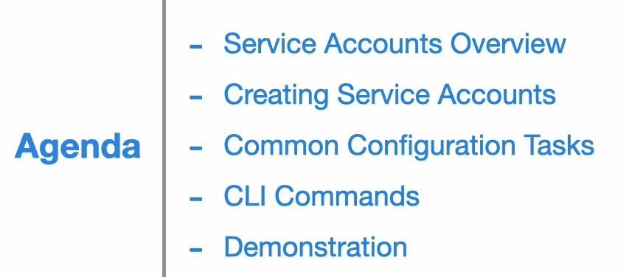

Slide 2


Slide 3


Slide 4
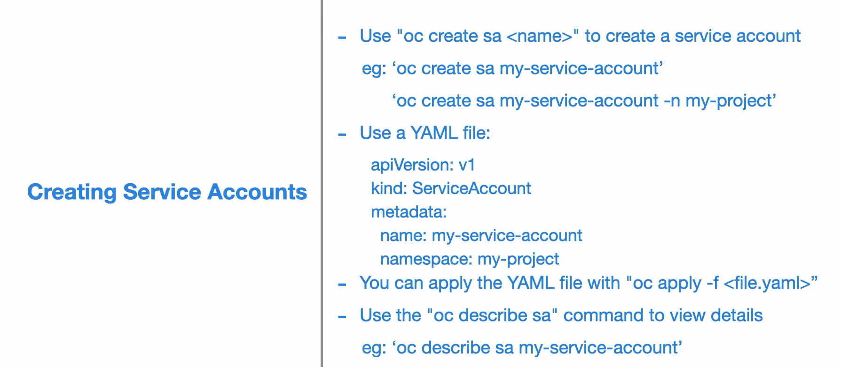

Slide 5


Slide 6
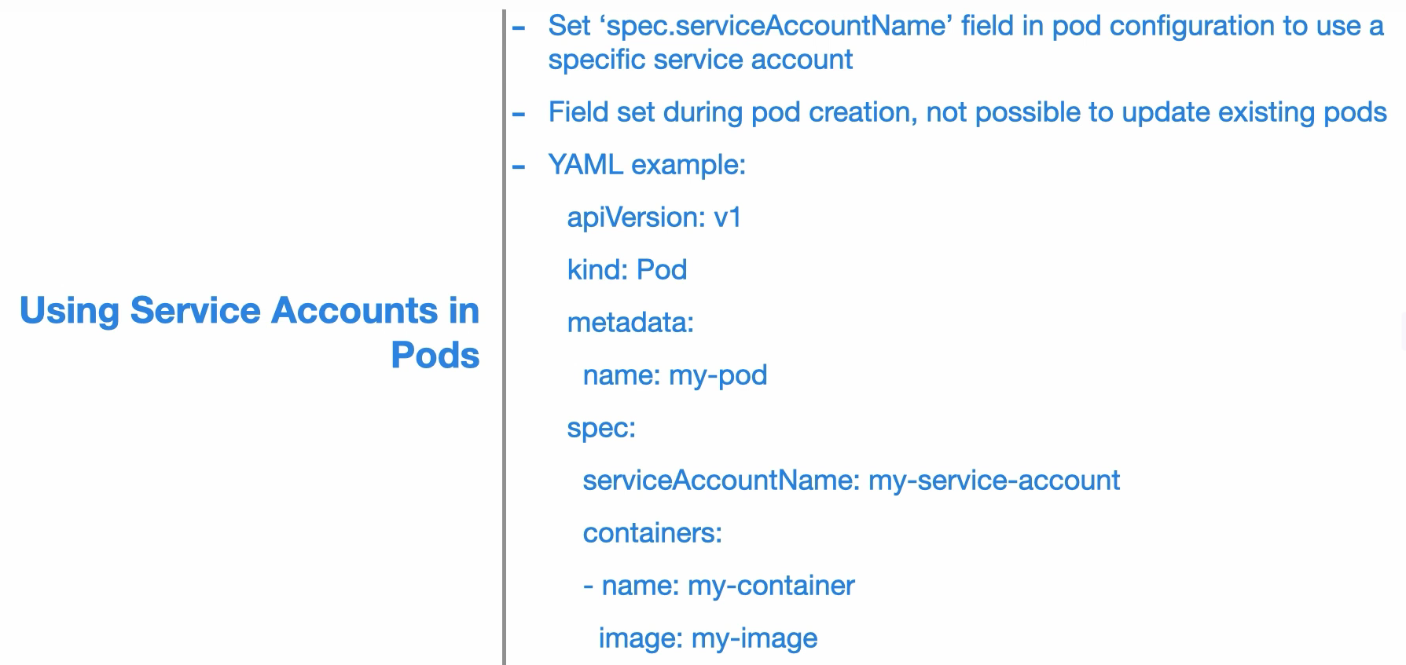

Slide 7




Slide 8
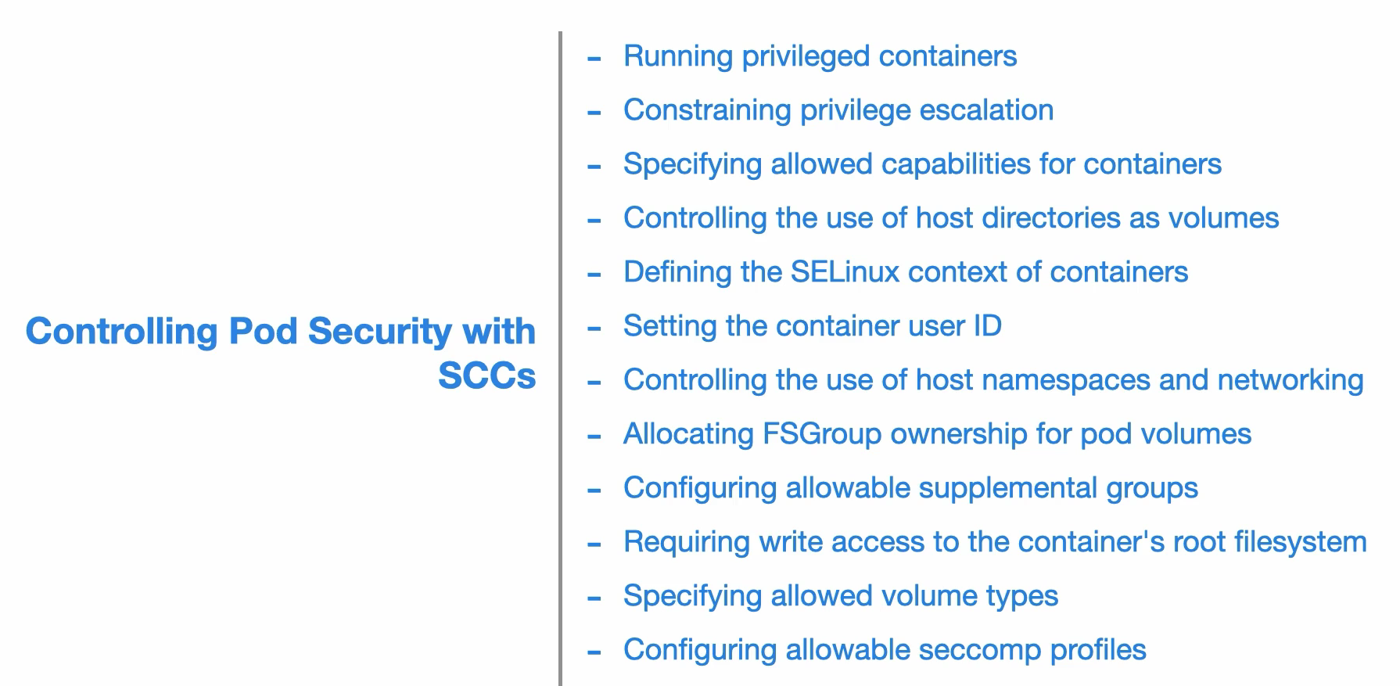

Slide 9
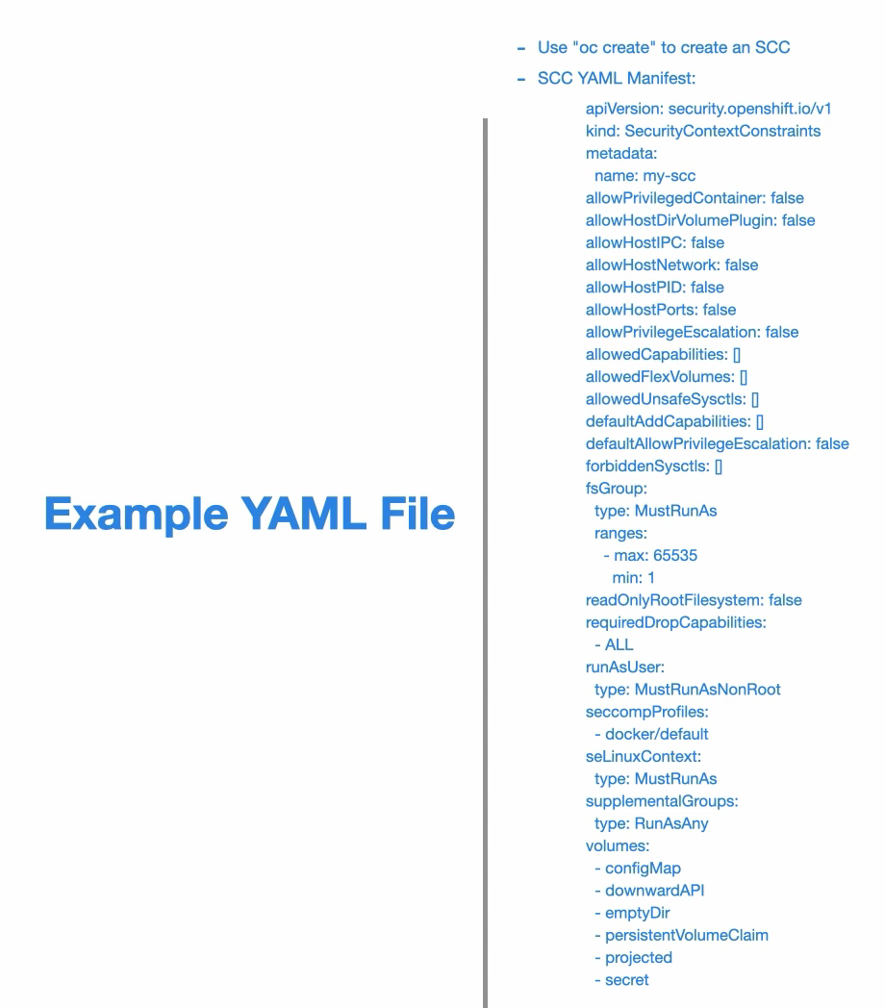

Slide 10



Slide 11


Slide 12



Slide 13


Slide 14
Application access to k8s API

Slide 15


Slide 16


Slide 17



Slide 18


Slide 19


